Slide 1
Comprehensive Digital Marketing for Amul

Slide 2
Presented by : 1. GOOTY MOULA HUSSAIN 2. ORUGUTOLU MAHESWARI 3. B.R.VISHNU KANTH 4. DASARI BHARATH KUMAR 5. JANGAM SHIVA From : S.S.G.S DEGREE COLLEGE

Slide 3
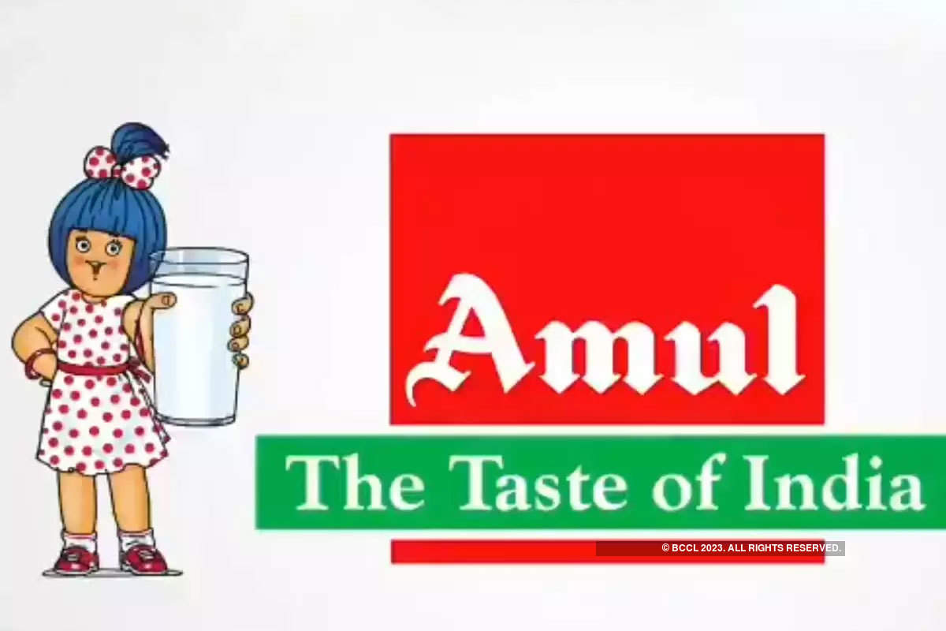
Part 1 : Brand study, Competitor Analysis & Buyer’s/Audience‘s persona
Research Brand Name : “Amul”

Slide 4
History of Amul : A small town in the state of Gujarat in western india. The exploitative trade practices followed by the local trade cartel triggered off the corporative moment. Angered by unfair and manipulative practices followed by the trade ,the farmers of the district approached to the great Indian patriot Sardar vallabhbhai Patel for a solution. He advised them to get rid of middlemen and form their own co-rporative, which would have procurement, processing and marketing under their control. In 1946 , The farmer of this area went on a milk strike refused to be cowed down by the cartel. Under the Inspiration of Sardhar Patel , and guidance of leaders like Moraji Desai and Tribhuvandas Patel , they formed Together their own corporative in 1946.

Slide 5
This co-rporative , The kaira District Co-operative Milk Producers Union Ltd. Started with two village Dairy Co-operative society’s and 247 liters of milk and it’s today it’s better known as Amul Dairy Amul grew for strength to strength. The then Prime minister of India, Lal Bahadur Shastri decided that the same approach become the basis of a national Dairy Development Policy. He understood that Amul success could be attributed to four important factors. The formers owned the Dairy their elected representative managed the village society’s and the district union, they employed professionals to operate the Dairy and manage it’s business. At his instance in 1965 the national Dairy Development Board was set basic objective of replicating the Amul model. Dr .Kurien was chosen to head the institution as it’s chairman and asked to replicate this model all over the country.

Slide 6
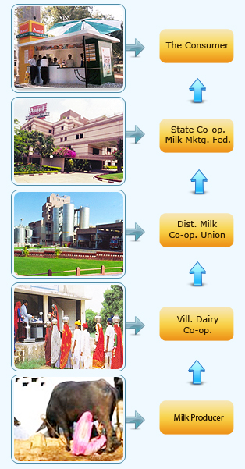
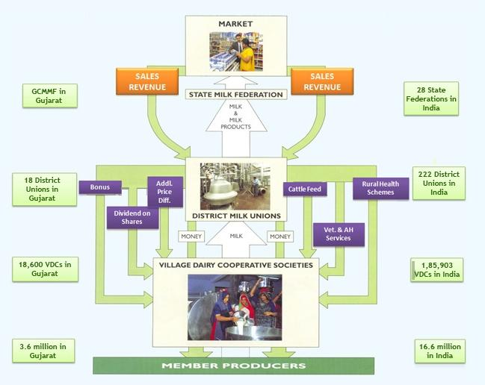
1. Establishment of a direct linkage between milk procedure and customers by. eliminating middlemen. 2. Milk Procedures (farmers)control procurement, processing and marketing. 3. Professional management.

Slide 7
The Amul model has helped India to emerge as the largest milk procedure in the world .More than 16 million milk procedures pour their milk in 185903 Dairy corporative societies across the country. Their milk is processed in 222 District Co-operative milk unions and marketed by 28 state marketing federation, ensuring a better life for millions. Mission : GCMMF endeavour to satisfy the taste and nutritionalrequirements of the customer of the world through excellence in the marketing by the committee team. Through corporative networking, they are committecommitted to offer quality product that provides best value for money.

Slide 8
Values : - customers Orientation - Gives a customer good and fair deal Great customer relationship . and take time. Do not try to maximize profitS at the expends of those enduring relationships. USP : The main USP of Amul brand is its low price .It hits the translation by reducing the prices on It’s project portfolio . The competitive advantage is its “Backward integration strategy”, which helps substantially In cost reduction .

Slide 9
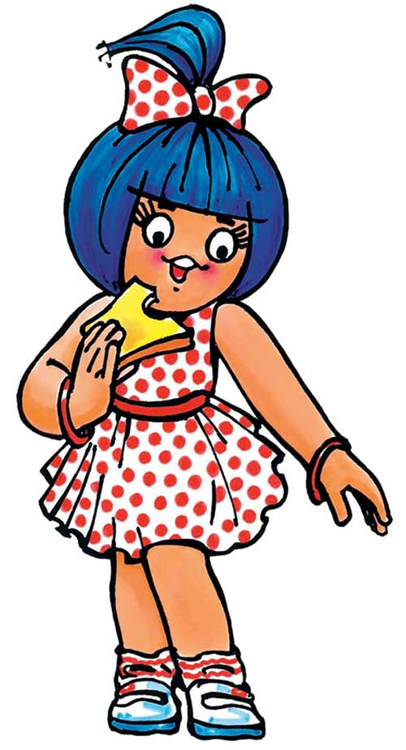
Amul Brand tone : Amul brand tone is “The Taste Of India”. Amul uses a mix of humor, pun and sarcasm to engage with their audience. It’s help them to increase above the clutter of boring content that plaques the internet. The other brands tend to be serious. Too much seriousness can end up becoming monotonous. Amul Brand Identity : Amul brand identity is “Amul Girl” a young girl in a polka-dot drdress who has become synonymous with the brand .This identity makes Amul top brand in India .

Slide 10
5 smart goals : Achievable : Amul Dairy should have the resources and finances necessary for being able to realize the organizational goals Over the long haul.Amul Dairy should also have the strategic leadership to be able to achieve these goals. Time-frame defined : This is important to ensure that the organization is efficient and effective in realizing its goals. An attached time frame for the goals set for the long term future also helps in establishing a related time frame for the momore short term organizational objectives.

Slide 11
Easy to understand : The goals should be fairy simple and should easily understood by all employees of Amul Dairy .This is important when employees are clear about what the goals are and their importance and agency of achieving them will they be able to relate with them and work towards achieving them. Easy to communicate : The goals set by Amul Dairy should also be easy to communicate. This means that the jargon used for goals setting and goal communication should be clear and precise. These goals should be communicated with all managrial levels, and all employees to allow them a directive path to help the organization achieve these goals. Pragmatic : The goals set by the Amul Dairy should also be realistic in nature. This means that all strategic goals defined by Amul Dairy should take into consideration

Slide 12
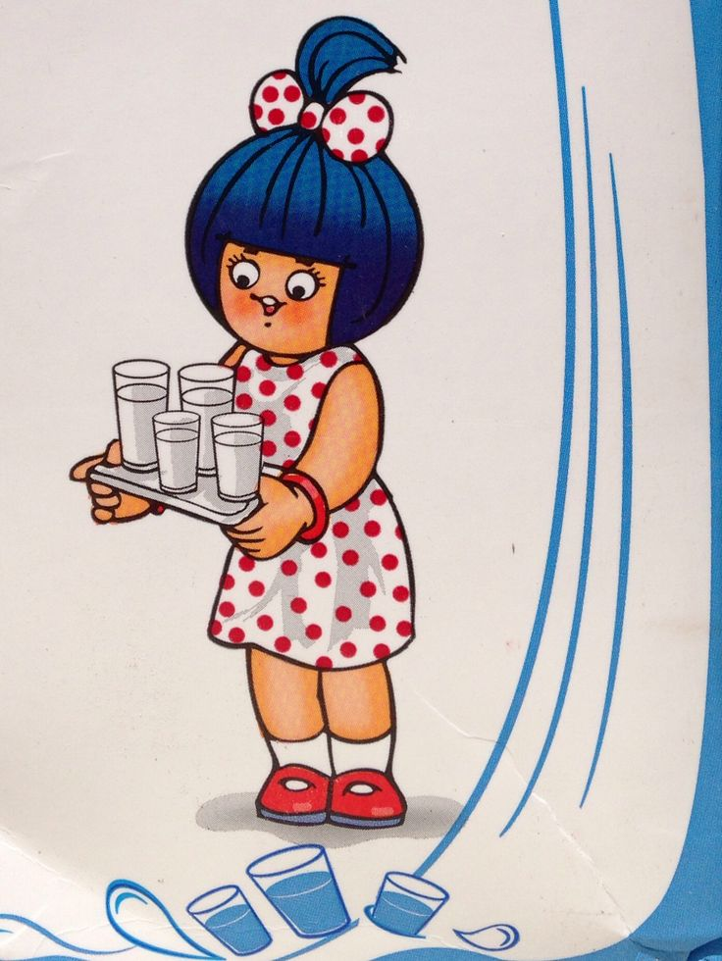
Not only its internal financial position and resources but also the skill set of its employees and the larger macro environment. This will enable the company to set goals that will sue the core competencies of Amul Dairy to help it achieve the strategic goals easily, and realistically. Amul KPI’s : 1.Valume of milk procured 2.Response Time for milk collection 3.Waste rate during production 4.Consistency in the quality of Milk 5.Payments and distribution tracking 6.Time Lang in the payments to the suppliers

Slide 13
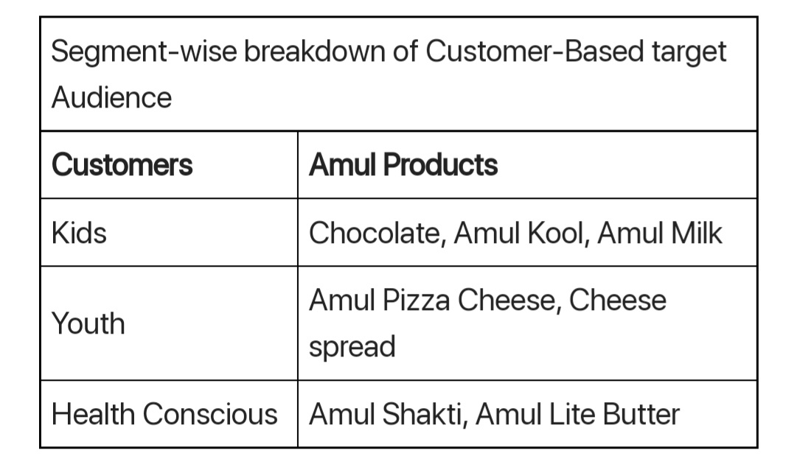
Buyers/Audience‘s persona :

Slide 14
Competitor Analysis : Competitor 1 : Mother Dairy USP : India’s very own producer of milk, milk products, beverages, foods, etc. At affordable rates and of premium quality. Mother Dairy swot Analysis : Strength : 1.Awell-recognized brand name 2.Popular subsidiary brands like Dhara , Safal, b-Activ, etc

Slide 15
Weakness : 1.Limited number of Mother Dairy and Safal outlets. 2.Difficult to maintain competitive pricing 3.Vegetables and milk products are perishable . Opportunities : 1.continuous demand of dairy products and other products by Mother Dairy. 2.Open more number of Mother Dairy outlets 3.Market and advertise the products. Threats : 1.Strong marketing muscle by competitors

Slide 16
Competitor 2 : Cadbury USP :Cadbury is one of the biggest and most trusted chocolate brand worldwide. Cadbury Swot Analysis : Strength : 1.Cadbury has a high brand equity and top of the mind chocolate brand . 2.Strong brand recall and customers loyalty among Cadburys customers. 3.Strong parent brand of kraft food gives a strong backing . 4.Cadbury is a trusted and premium quality brand.

Slide 17
Weakness : 1.A few controversies regarding advertising , worms etc. Made international news. 2.A few instance of product recall hampered Cadbury’s brand image. Opportunities : 1.Cadbury can increase reach in rural markets. 2.Increase it’s reach and presentation in untapped markets. 3.Diversification of product range into related food segments . Threats : 1.health consciousness amongst people Can reduce intake of chocolates . 2.Increase in cost of raw materials.

Slide 18
Competitor 3 : Kwality walls USP : Kwality walls USP is its focus on the highest quality ingredients and wide variety of flavors it offers to customers. Kwality walls Swot Analysis : Strength : 1.Strong brand name . 2.Excellent advertising and visibility. 3.Good product distribution and availability. 4.Lots of flavors and varieties available.

Slide 19
Weakness : 1.Food products have a limited shelf life. These were the weakness in the Kwality walls Swot Analysis. The weakness of a brand are certain aspects of its business which it can improve. Opportunities : 1.Better and newer flavors. Above we covered the opportunity in kwality walls Swot Analysis. The opportunity for any brand can include prospects of future growth.

Slide 20
Threats : 1.Threat from existing ice-cream brands. 2.Local Kulfis. The threats in the Swot Analysisof kwality walls are as mentioned above .The threats for any business can be external factors which can negatively impact it’s business.

Slide 21
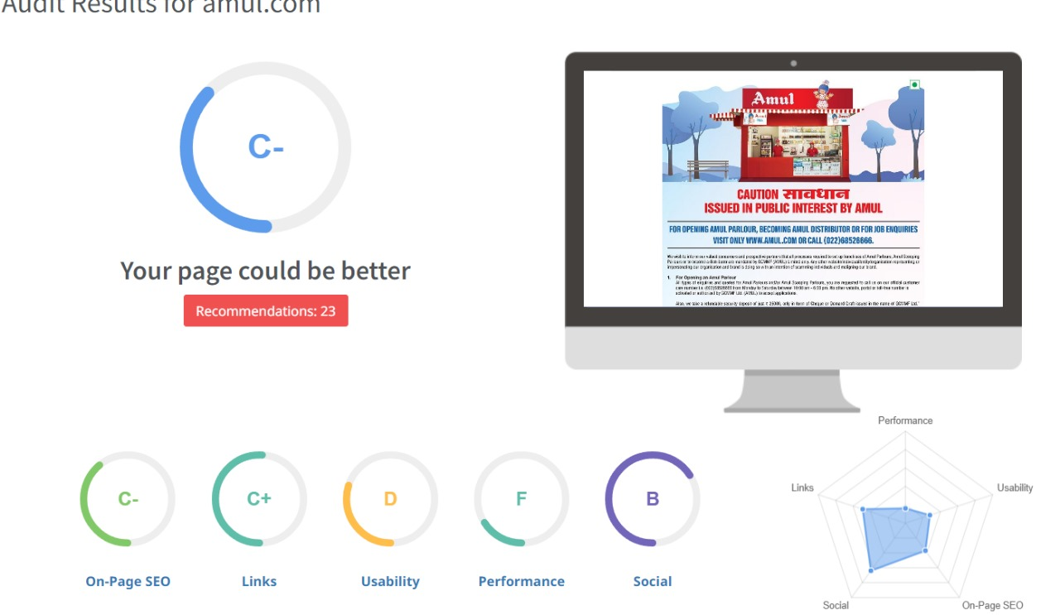
Part 2 : SEO & Keywords Research
SEO Audit :

Slide 22
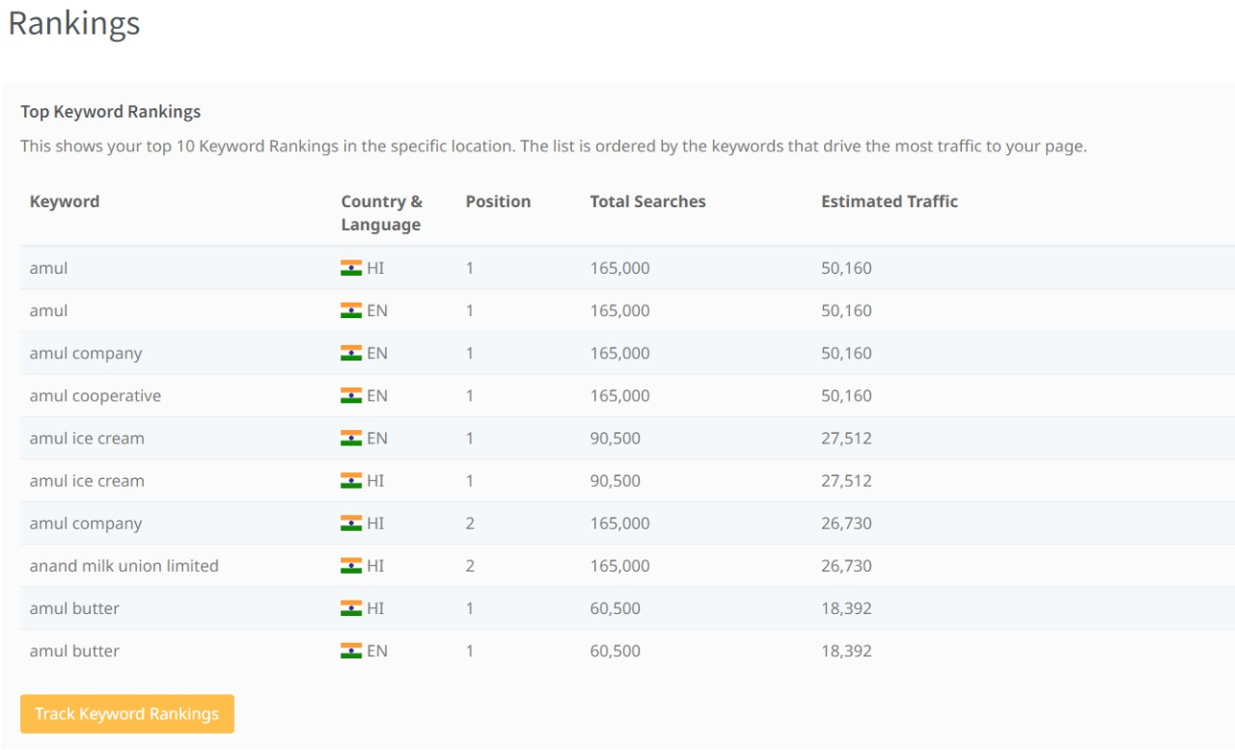

Slide 23
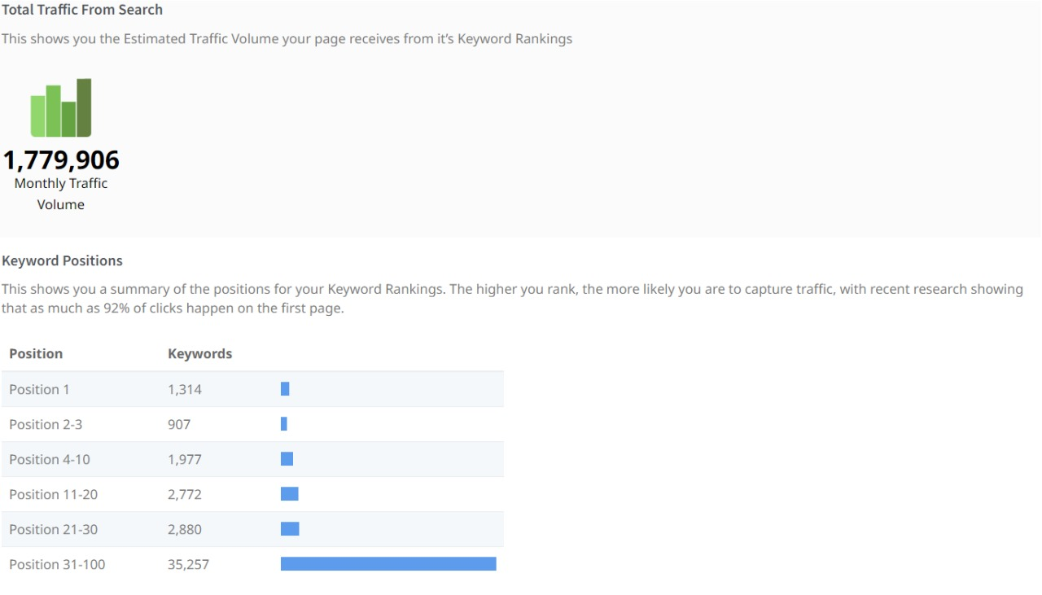

Slide 24
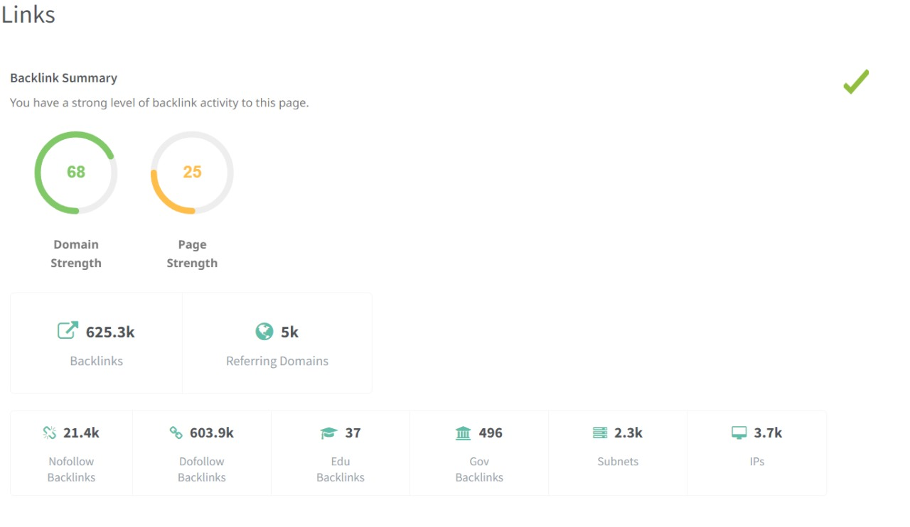

Slide 25
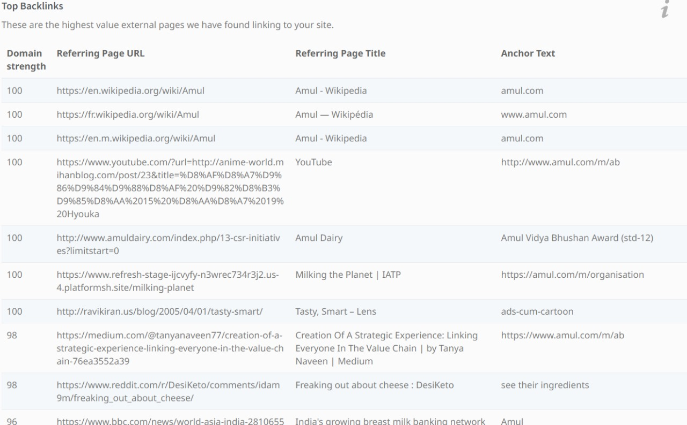

Slide 26
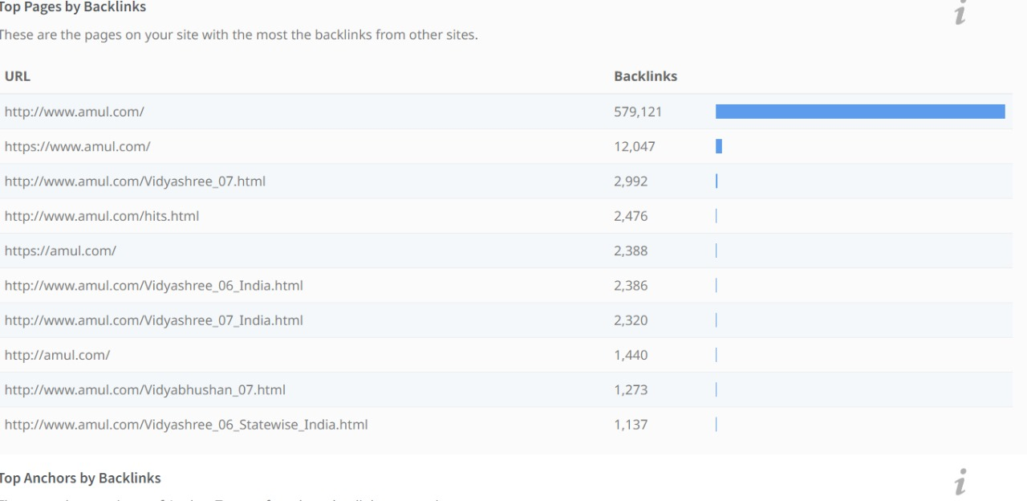

Slide 27
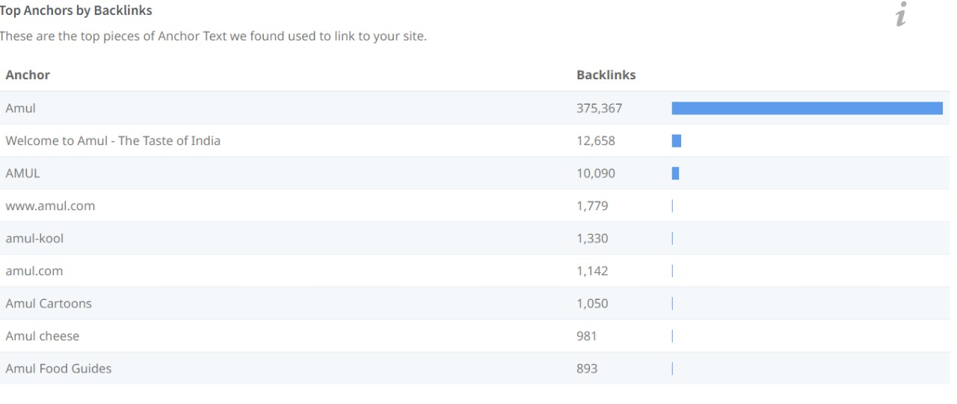

Slide 28
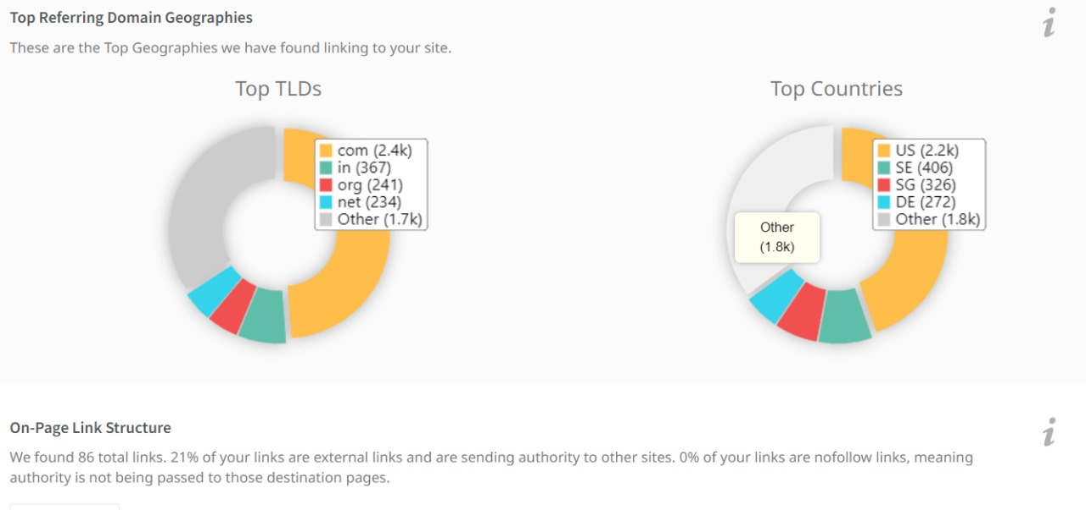

Slide 29
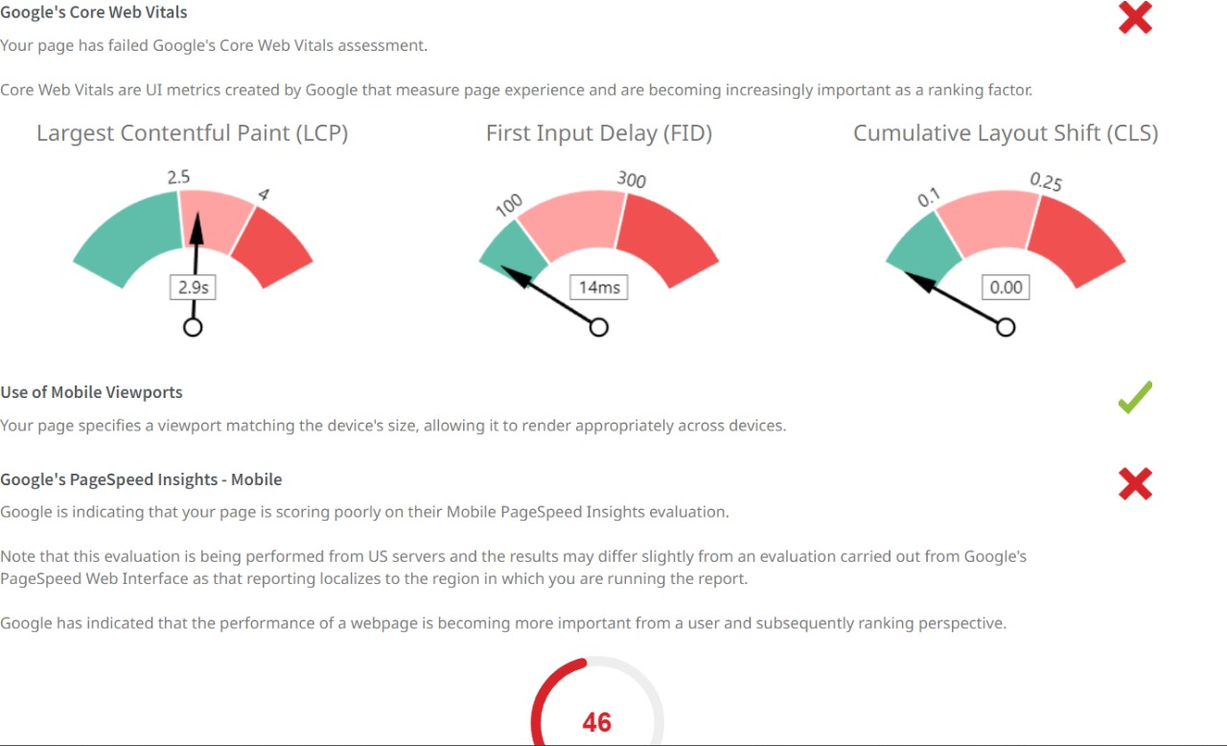

Slide 30
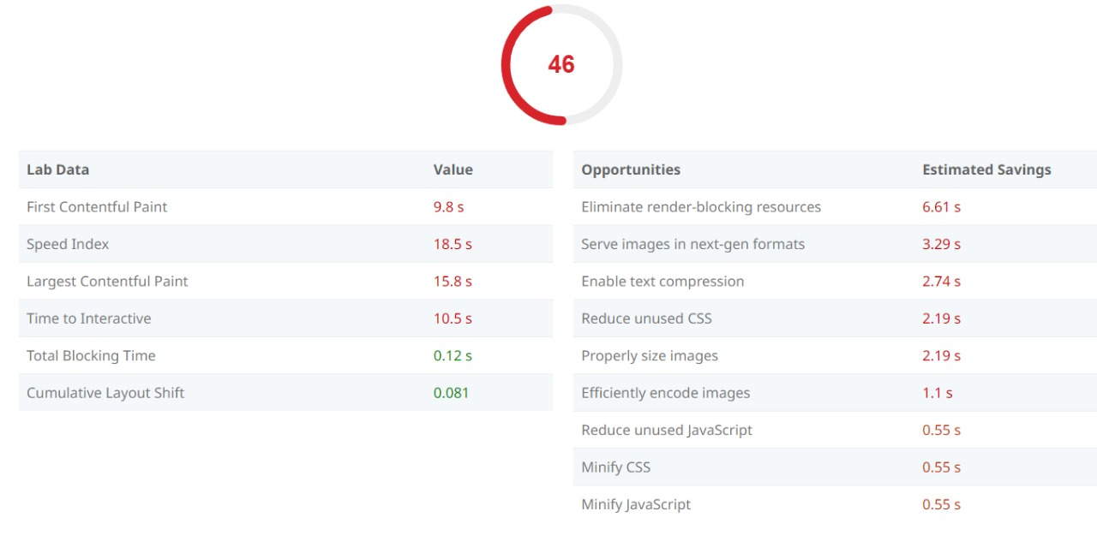

Slide 31
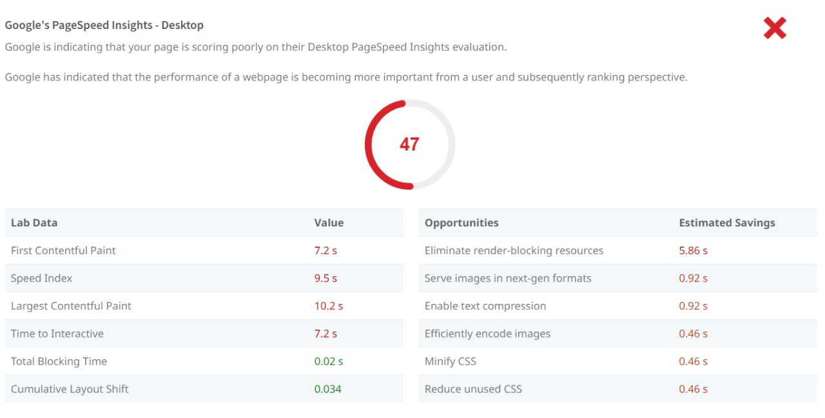

Slide 32
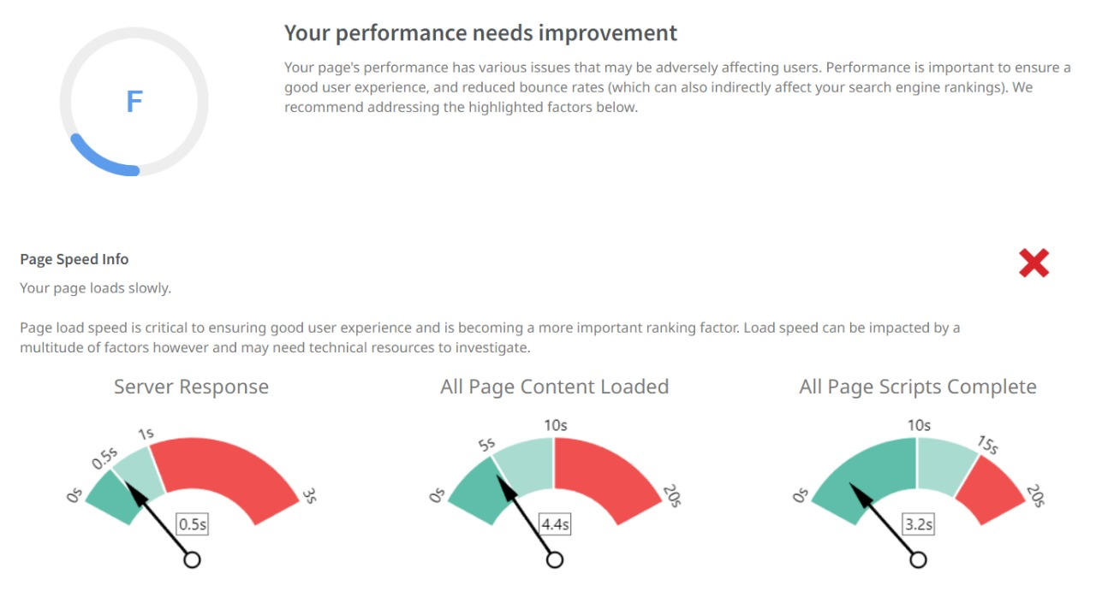

Slide 33
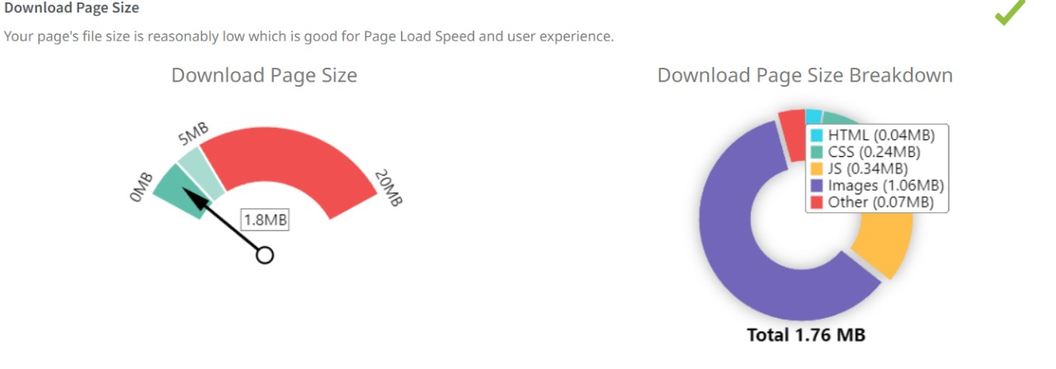

Slide 34
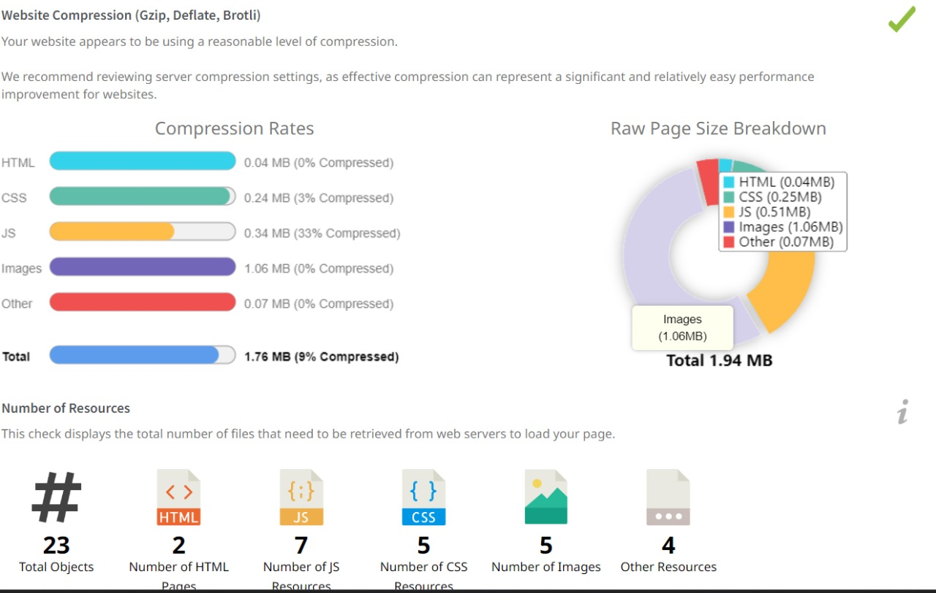

Slide 35
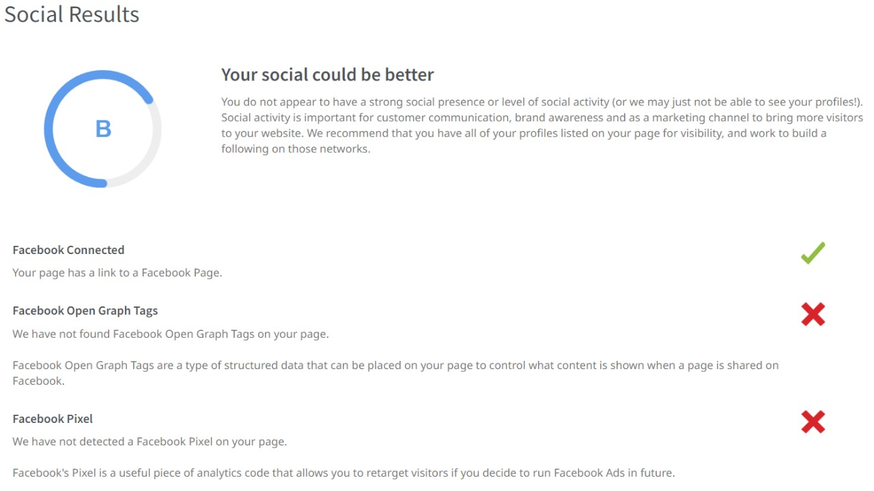

Slide 36
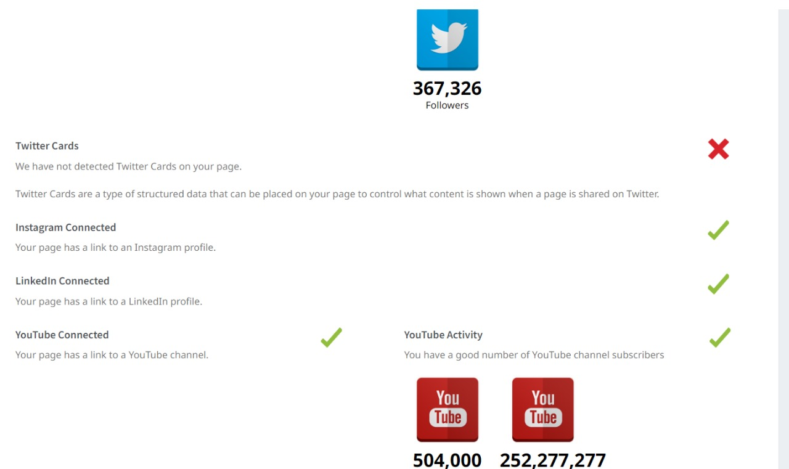

Slide 37
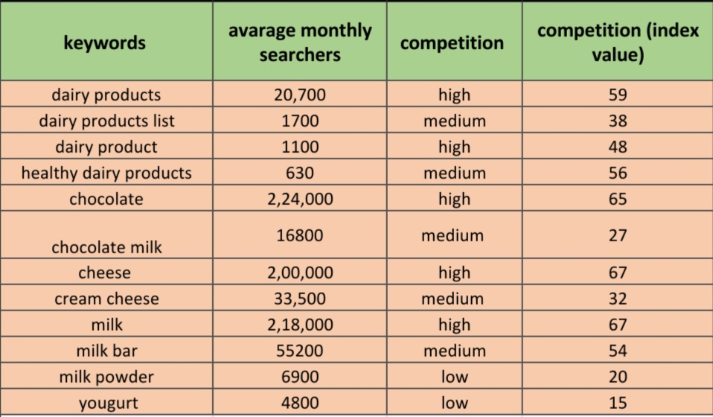
Keyword Research : Brain Strom Seed keyword :

Slide 38
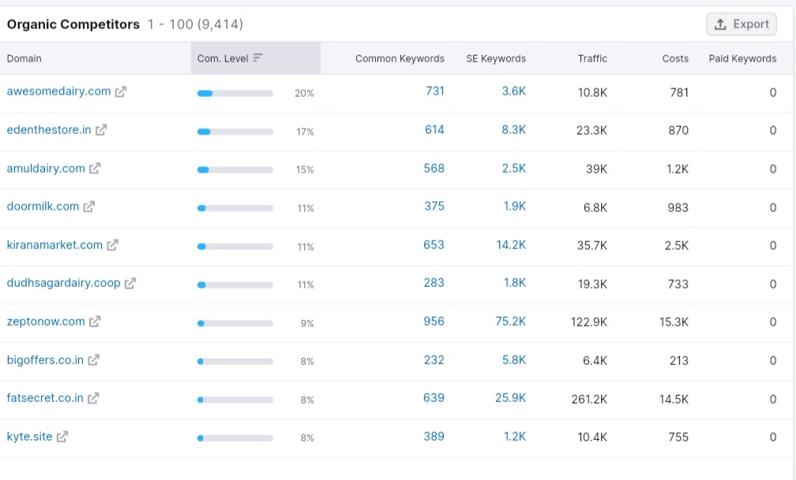
Competitor keywords :

Slide 39
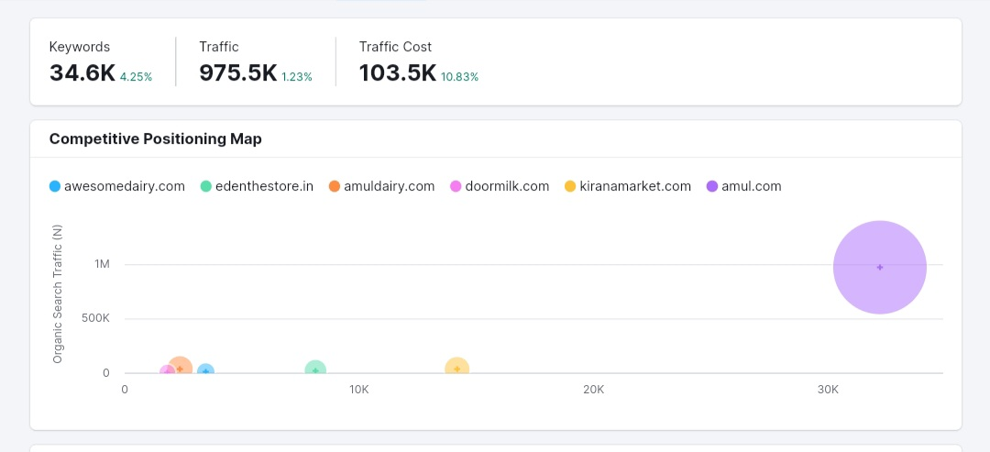

Slide 40
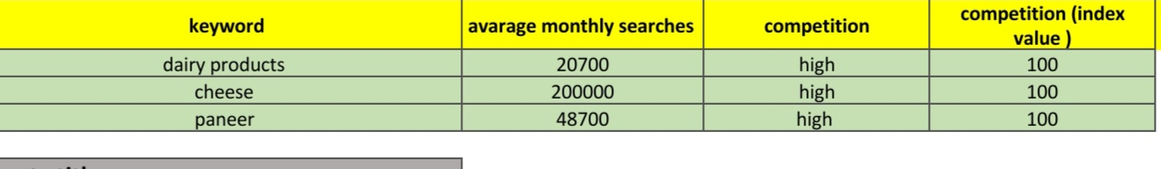
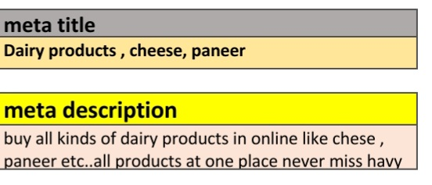
On page Optimization :

Slide 41
Part 3 : content Idea’s and marketing strategy
Content ideas and marketing strategstrategies
Amuls Marketing strategy :
Amul unique and innovative marketing strategies differentiate it’s from other Dairy brands . There is no other single Dairy product campaign in india. Amul competitive market with it’s smart marketing campaigns.

Slide 42
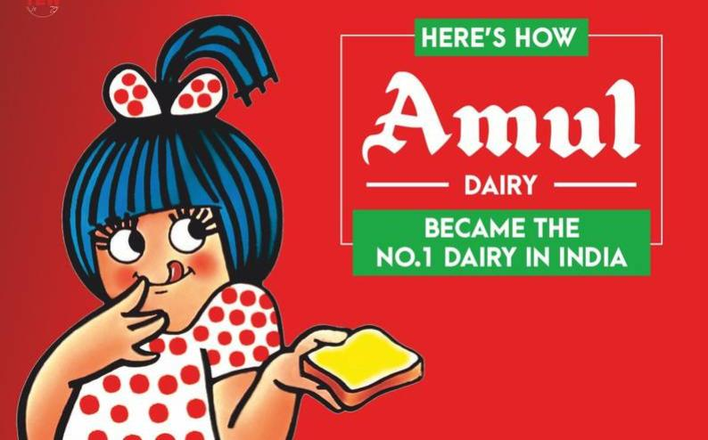
1 . Amul’s ad girl marketing strategy : Here it’s the amul girl beautiful drawing of a girl which Amul created in 1967 in response to its rival brand .it’s the most Loved icon ad in india. Amul uses this girl In every ad .The activities of the girl Change according to the ads. You can see her doing yoga in some ads , and playing cricket in others. Using this icon is Amul’s best marketing strategy .

Slide 43
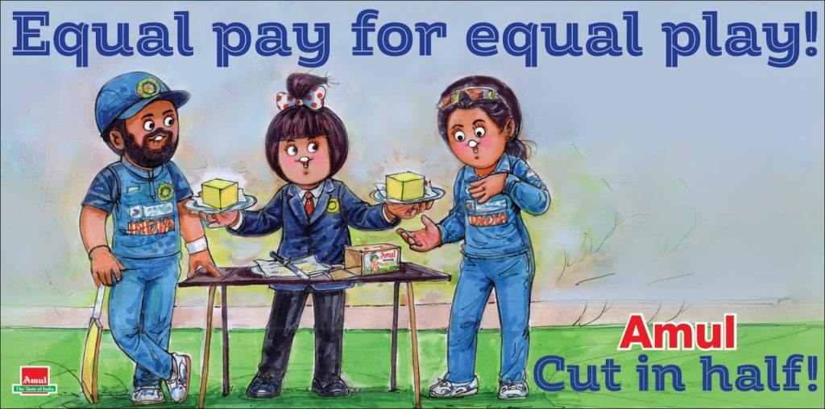
2.Moment marketing strategy of Amul : Amul using this moment strategy for decades now. Previously It was in news papers now it’s on social media platforms . Here this image Amul used This latest news of equal pay for both men and women . This is the innovative marketing strategy of Amul.

Slide 44
3. Low – cost and high marketing strategy : Amul target the mass media market. It sells quality product and fair price that everyone can buy. This increase customers. It’s effective market. 4.Smart Tagline marketing : Amul popular taglines are “Amul Doodh pita Hai India” and “The taste of India”. These taglines attracts the audience.

Slide 45
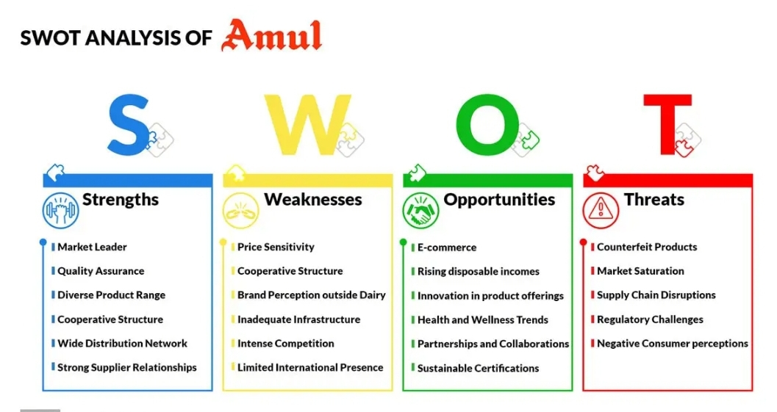
Swot Analysis of Amul :

Slide 46
Pari 4 : content creation & curation
Post creation :
Select content categorcategories :
Format 1 :Amul To invest 5000 crore to set up Milk processing plants .
Gujarat Corporative Milk Marketing Fedaration , which sells under the Amul brand, will invest 5000 crore over the next two to three years ,largely into milk processing plants across the country.
Amul managing directer Jayen Mehata said ,”we would be adding about 15-16 new plants,as we plan to go closer to the customer”.

Slide 47
The country’s largest brand is building a modern facility in it’s home state Gujarat’s Rajkot district, which will produce 20 lakh liters of milk a day , Mehta told BQ prime .it’s set up a plant each into two cities of Uttar Pradesh-Varanasi and Bhagpat –to produce 10 lakh liters a day. “We also looking at setting up new ,modern plants in Kolkata and pune”. Format 2 : Amul vs Nandini ni controversy in Karnataka : All you need to know . Gujarat- based Dairy corporative Amul’s announcement on April 5 to enter the karnataka market to supply it’s milk and curd has given the apposition yo fire at the ruling BJP.much as it came months after union home minister Amit shah’s that the two brand’s corporation could do wonders for the Dairy sector.

Slide 48
The apposition congress and the JD(s) have trained their guns at the ruling Bharatiya Janata Party in the state when the assembly election are one month away expressing fear that Nandini the Rs . 21,000 crore brand From the karnataka milk Fedaration. Could be merged with the Gujarat-based amul. The people of the state have an emotional connect with Nandini. Format 3 : Amul hikes milk prices by Rs 3/liter. Amul has hiked the price of milk by Rs3 per liter across all variants. The Gujarat co-rporative Milk Marketing Fedaration (GCMMF) that markets it’s product under the Amul brand Has hiked it’s prices .GMCCF said in a release : “We would like to inform you that the price of Amul pouch milk (all variants) Has been raised upwards as under

Slide 49
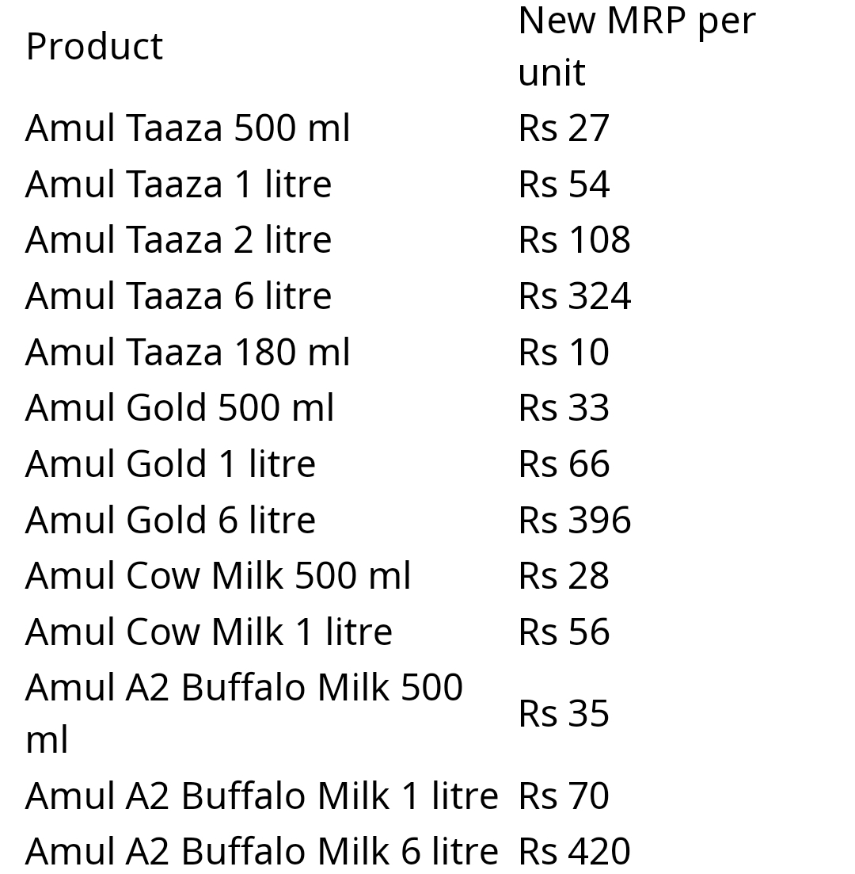
W.e.f. February 2,2023 night dispatch ( February 3, 2023 morning ).” Here is the latest price of Amul

Slide 50
Instagram Story : Account link : https://instagram.com/amul_no1_taste?utm_source=qr&igshid=MzNlNGNkZWQ4Mg== Day 1 Story link : https://instagram.com/stories/amul_no1_taste/3214153213758188460?utm_source=ig_story_item_share&igshid=MTc4MmM1YmI2Ng== Day 2 Story link : https://instagram.com/stories/amul_no1_taste/3214552361049465320?utm_source=ig_story_item_share&igshid=YjA3ZDljY2FiMw==

Slide 51

Video of Amul :

Slide 52
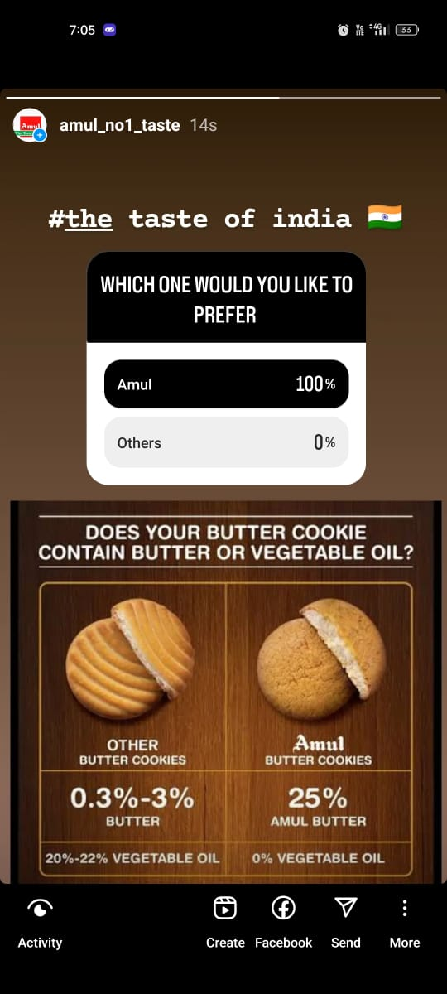
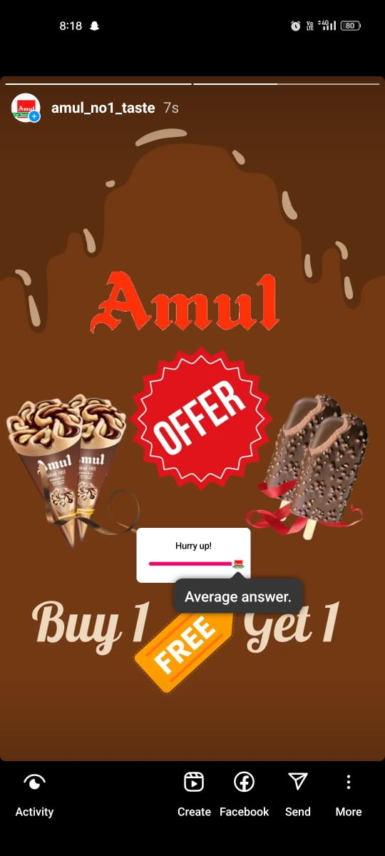
Instagram Story Screenshots : Day 1 : Day 2 :

Slide 53
Group leader GOOTY MOULA HUSSAIN My contribution to the project : As a team leader I planed the process of project and l assigned topics to my team members and guid them . I worked to collect the Brand study ,buyers audience persona and competitor Analysis and gathered the data to my project .In the process of working on my project I learned so many new things that I never knew before it will help me to explore more about the new topics and inspired me to work more .

Slide 54
Team members-1 ORUGUTOLU MAHESWARI My contribution in this project : I am one of the member of this project . I was assigned to Research SEO Audit , Keyword Research and to prepare the PPT presentation . In this process I learnd new things through the Research and want to explore more about the different platforms on Digital Marketing to build my skills .Through this project I learned so much practical experience to get selfknowledge in different paths and it’s show me what I am and increase my self confidence to achieve anything what I want .

Slide 55
Team member-2 JANGAM SHIVA My contribution in this project : In this project I worked to make instagram reels , video editing to show my editing skils on this project through this project I know about different platforms on social media marketing and how to campaign different content to attract the customer .

Slide 56
Team members-3 BR .VISHNU KANTH My contribution in this project : In this project I worked to collect the content formats. In this process I am addicted to know and curious about latest news and to learn more about the different paths . It will help to perform better in given project and give my 100 percent effort on them.

Slide 57
Team members-4 DHASARI BHARATH KUMAR My contribution in this project : In this assigned project I worked to gathered data about marketing strategies about Amul and challenges facing the brand this helps me to learned about the top brands strategies and the digital marketing campaign on social media and strategies that are using increase marketing sales it will help me to increase my skills in this platform.

Slide 58
Thank you

